Slide 1
Re-Engineering process flow
3. Software restructuring

Slide 2
Software Restructuring - Definition
Software restructuring is the process of transforming an existing software system into a better-structured, more understandable, and maintainable form without altering its external behavior.
Its purpose is to:
Reduce complexity
Improve maintainability
Modernize old systems
Prepare a system for re-engineering or migration
Improve performance (sometimes)
Improve reliability and consistency
Because restructuring deals with broader system transformation, software refactoring is one of its sub-activities.
Refactoring = code-level improvements.
Restructuring = code + data + architecture + documentation + UI rearrangement.

Slide 3
Why Software Restructuring Is Needed
Over time, software systems degrade due to:
Continuous patches and quick fixes
Poor initial architecture
Code duplication and spaghetti code
Outdated technologies
Lack of documentation
High software complexity
Legacy platforms (e.g., COBOL banking systems)
Data inconsistencies
As a result, restructuring helps revive the system for long-term sustainability.

Slide 4
Software Restructuring vs Software Refactoring (Short Summary)
Aspect | Restructuring | Refactoring
Scope | Large, system-wide | Small, code-level
Includes | Code, data, architecture, documentation | Only code
Purpose | Modernization & maintainability | Code clarity & quality
Behavior change | None | None
Example | Converting monolith → modules, DB restructuring | Renaming variables, extract method
Refactoring is a subset of code restructuring, while restructuring is a subset of software re-engineering.

Slide 5
Types of Software Restructuring
1. Code Restructuring (includes Refactoring)
Improving code organization and clarity while keeping functionality unchanged.
Techniques
Refactoring (Extract method, rename variable, remove duplication)
Eliminating dead code
Improving modularity
Removing code smells
Converting unstructured code into structured code
Splitting long methods/classes into smaller units

Slide 6
Examples
After
Version 1
if (x > 100) {
flag = true;
} else {
flag = false;
}
Version 2
flag = (x > 100);
Before
if(x > 100){
flag = true;
}
if(x <= 100){
flag = false;
}
Problems:
Two separate if statements
Redundant conditions
Can lead to errors if modified later
Not efficient

Slide 7
2. Data Restructuring
Reorganizing data storage and structures to enhance integrity and consistency.
Techniques
Database normalization
Data model redesign (ERD)
Migrating from flat files → Relational DB
Removing redundant fields
Converting data formats (CSV → SQL → JSON etc.)
Updating schemas for modern systems
Examples
COBOL flat files → Oracle/MySQL tables
Legacy field packing → modern structured types
CSV
AccountNo,Date,Type,Amount
1002334556,2025-02-11,Deposit,1200
1002334556,2025-02-11,Withdrawal,300
1044557889,2025-02-11,Deposit,500
SQL
INSERT INTO Accounts (AccountNo, Balance)
VALUES (10001, 5000);
JSON
{
"firstName": "John",
"age": 30
}
Notes:
Database normalization is a process used in database design to organize data efficiently, reduce redundancy, and ensure data integrity. It involves structuring a relational database into tables and columns in a way that makes the data consistent and easy to maintain.
A CSV file is a plain text file where:
Each line = one row
Values inside the row = separated by commas (,)
QL stands for Structured Query Language. It is a standard programming language used to store, manage, and retrieve data in relational databases.
JSON stands for JavaScript Object Notation is a lightweight data-interchange format that is easy for humans to read and write, and easy for machines to parse and generate. Despite the name, JSON is language-independent and has become the de facto standard for data transmission between a server and web applications.

Slide 8
3. Architectural Restructuring
Transforming the system’s architecture while keeping the same functionality.
Techniques
Monolithic → Layered → Modular → Microservices
Transforming legacy APIs → RESTful services
Migrating from client-server to cloud architecture
Decoupling tightly coupled modules
Introducing design patterns (MVC, Observer, Facade)
Examples
Banking system COBOL → service-oriented architecture (SOA)
Splitting a huge application into domain-based services

Slide 9
Monolithic → Layered → Modular → Microservices
Imagine a small, successful e-commerce business that built its entire application as a Monolith.
Phase 1: The Initial Monolith
The application is a single, large code base where all business functions are tightly coupled and share a single database.
Component | Function
Presentation Layer | The website/UI for customers.
Business Logic | Everything: Product Catalog, Order Processing, User Accounts, Payment Gateway integration, Inventory Management.
Data Access | All components directly access a single, shared database (e.g., one large PostgreSQL instance).
Deployment | The entire application must be compiled and deployed as a single unit (e.g., one large Java WAR file or a single deployment package).

Slide 10
Phase 2: Architectural Restructuring (Migration to Microservices)
The company decides to restructure the architecture using the Strangler Fig Pattern, where new services are built to replace parts of the monolith one by one.
The single Monolith is decomposed into independent microservices, each owning its business capability and its own data store.
New Microservice | Business Capability | Independent Technology Stack | Data Store
User Service | Manages user sign-up, login, and profiles. | Java/Spring Boot | SQL Database
Product Catalog Service | Manages product information and search. | Python/Django | NoSQL (for fast read/write)
Order Service | Handles placing, tracking, and canceling orders. | C#/.NET | SQL Database
Payment Service | Integrates with third-party payment gateways. | Go | In-memory cache

Slide 11
How the Restructuring Works (The Strangler Pattern):
Introduce an API Gateway: A new service is placed in front of the Monolith to route incoming requests.
Extract the first service (e.g., User Service):
The User Service is built as a separate microservice with its own database.
The API Gateway is configured to redirect all user-related requests (e.g., /api/users/*) from the Monolith to the new User Service.
The old User module is removed from the Monolith.
Repeat: The company repeats the process for the Product Catalog, Order, and Payment components until the Monolith is "strangled" and all its functionality has been replaced by smaller, decoupled services.
The final architecture is a Microservices Architecture.

Slide 12
4. Interface Restructuring
Updating and reorganizing user interfaces while keeping the workflow same.
Techniques
Improving layout, UI grouping
Updating navigation styles
Improving accessibility
Introducing UI consistency standards
Example
Same data fields but cleaner placements, grouping, and accessible UI.

Slide 13
5. Documentation Restructuring
Rewriting or reorganizing system documentation.
Includes:
API documentation updates
Sequence diagrams
Class diagrams
Architecture or design documents
System overview
Module-level descriptions

Slide 14
Software Restructuring Process (Step-by-Step)
Step 1: System Understanding
Reverse engineering
Static and dynamic code analysis
Architecture reconstruction
Data dictionary creation
Step 2: Identify Problem Areas
Code smells
High complexity modules
Duplication
Dead or unreachable code
Poor modularity
Outdated data formats
Architectural bottlenecks
Tools: SonarQube, CodeMR, SciTools Understand.

Slide 15
Step 3: Define Restructuring Strategy
Select components to modify
Identify target architecture
Decide modular boundaries
Select refactoring rules
Create a restructuring plan
Step 4: Transform System
Apply code refactoring
Apply architectural restructuring
Improve data schemas
Modify interfaces
Update documentation

Slide 16
Step 5: Validate Functionality
Regression testing
Automated test suites
Integration testing
Step 6: Deploy & Document
Update system documentation
Update configuration files
Deploy improved system

Slide 17
Techniques Used in Software Restructuring
A. Refactoring Techniques (Code-Level)
Extract method / class
Replace magic numbers
Simplify conditional expressions
Introduce design patterns
Remove code duplication
Replace long switch-case with polymorphism

Slide 18
B. Data Restructuring Techniques
Normalization (1NF, 2NF, 3NF)
Schema redesign
Foreign key establishment
Data migration scripts
ETL transformations
C. Architecture Restructuring Techniques
Modularization
Component decomposition
Service extraction (Microservice)
Introduction of APIs
Removal of cyclic dependencies
Event-driven architecture adoption

Slide 19
D. Reverse Engineering Techniques Supporting Restructuring
Static analysis
Dynamic analysis
Call graphs
Control flow graphs
Abstract syntax tree (AST) analysis

Slide 20
Tools for Software Restructuring
Code Analysis & Refactoring Tools
SonarQube
PMD, Checkstyle
IntelliJ, Eclipse, PyCharm built-in refactor tools
SciTools Understand
Architecture Reconstruction Tools
Visual Paradigm
Enterprise Architect
CodeMR
Rational Rose
Data Restructuring Tools
ERWin / ER-Studio
Oracle Migration Tools
SQL Server Migration Assistant
Talend / Informatica

Slide 21
Refactoring
Refactoring is the process of improving the internal component of an old system without changing its external environment. It’s a great choice to make modifications in the configuration, solve technological issues, and make the code more clear and maintainable.
Refactoring makes the system more flexible so it can easily adjust to the current circumstances. This approach is recommended for businesses that want to move from containers to microservices in order to avoid software failures.
Code refactoring is basically the process of restructuring an application’s code without changing it. It also doesn’t add up to its behavior and functionality. Its purpose is to make the code more efficient and easily maintainable.
Notes:
Containers virtualize multiple application runtime environments on the same operating system instance, providing isolation and portability. Containerized microservices offer reduced overhead, increased portability, faster application development, and easier adoption of a microservices architecture.

Slide 22
What is Refactoring Legacy Code?
Refactoring legacy code is the process of improving the structure of an old or unfamiliar code without changing its functionality. The idea is to clean up lines of complex codes so you can understand or work with them better. This may include reducing redundancies or errors to make the code readable and manageable.
While refactoring a legacy code may sound similar to rewriting it, they differ.

Slide 23
In a code rewrite, developers would remove nearly everything to create a new code and implement new functionality from scratch. Refactoring is less extreme. Think of it like editing your old high school paper. When you review it, chances are you may find wordy sentences or repetitions that serve little use to the essay. When you improve these words without altering the meaning, that’s refactoring for programmers.
Legacy code refactoring works on the basic principle of cleaning up the code base to improve its performance, making it readable and easy to maintain.

Slide 24
There are various benefits to careful refactoring legacy code. For starters:
It makes code easy to understand: Refactoring code involves restructuring code in such a way that a new developer can work on it with minimal difficulties. When it’s understandable, identifying and fixing bugs becomes effortless.
It enhances maintainability: Organized code is easy to maintain and improve. It also makes updating the code pretty much straightforward.
It improves an application’s performance: With less complex codes, a software application functions faster.
It is cost-effective: In the long run, simplified and restructured code will be efficient. It also minimizes the risk of bugs, which is time and cost-saving.
It provides technical support: Technical support allows you to use third-party APIs that improve the functionality of your enterprise application. You will also receive updates that fix bugs and repair existing security holes.

Slide 25
Code refactoring
Reasons for the code being messy come from the developer’s inexperience, implementing shortcuts to meet tight deadlines, poor project management practices, or at least a few developers working on the same part of the project. It can also be a combination of all these factors.
As a result, you can get not only inefficient but also spaghetti code. Unnecessarily long and difficult to optimize. Without transparency, you can’t properly manage the application, fix bugs, implement new functionalities and introduce integrations with third-party solutions.

Slide 26
Here are some code refactoring examples. Or rather types of a “dirty” code that leaves a mark on an application’s performance:
unnecessary parts of code – removing them will not cause harm to the application
areas of code that require multiple changes for other parts of the code to work properly
tight coupling (you want low coupling and high cohesion)
incorrect or incomplete application of object-oriented programming principles
too large elements (code, methods, classes) that prevent easy manipulation
Code refactoring in these cases would consist of:
removal of an unnecessary portion of the code
simplifying code structure to ease cooperation between different portions of an application
simplification and disconnecting elements
proper implementation of object-oriented and functional programming principles
shrinking the size and weight of elements in the code

Slide 27
The goal of code refactoring is to write clean code having the following features.
Refactored code shouldn’t contain random variable names, poorly structured classes and functions, and magic numbers, etc. This helps improve readability and maintainability.
A refactored code shouldn’t have duplicate code snippets. A duplicate code makes it hard to introduce changes to the code in the future as developer needs to update the changes at multiple places. These changes may be hard to track and can produce errors.
A clean and refactored code must avoid bugs and it should pass most of the test cases.
Notes:
A code snippet is a reusable block of code. Such blocks of code are saved to keep track of good code that can be reused in the future.

Slide 28
When Should We Refactor a Source Code?
Code refactoring is good. But how do we know that we need to refactor the code? You can use the following criteria to decide on code refactoring.
The Rule of Three
The Rule of three says that when you are writing a code snippet for the third time in the source code, you should refactor your code.
When you are writing code for the first time, you need to write it for sure.
For the second time, it might seem repetitive but you should write the code.
When you need to write the same code snippet for the third time, refactor and create a function from the code.

Slide 29
Refactor Code While Fixing Bugs
Refactoring is one of the easiest ways to fix bugs in a code. If the code is messy and unstructured, bugs will be there for sure. Hence, you should always refactor your code to make it clean and readable to reduce bugs.
Refactor While Adding a Feature
When you are adding a new feature to a source code, it is the right time to refactor it. Whether or not the existing code is written by you, you should first refactor it to understand the existing functionalities and make the code clean and readable. This will help you add new features to the code easily as you will have an understanding of the code structure, naming conventions, etc.
Refactor After a Code Review
When your team reviews your code, they can point out the mistakes and anomalies in the code. Hence, you should do a code review, gather the inputs and then refactor the code before freezing the code.

Slide 30
Code smells
When the code requires refactoring, it is said to have a "smell". Of course, not literally, but such code really doesn't look very appealing.
Code is duplicated in multiple places.
A method is too long.
Groups of data attributes are duplicated.
A class has poor cohesion or high coupling.
A method has too many parameters.
Speculative generality - adding functionality that “we might need someday.”
Notes:
Speculative=hypothetically

Slide 31
More Code Smells
Changes must be made in several places.
Poor encapsulation of data that should be private.
If a weak subclass does not use inherited functionality.
If a class contains unused code.
If a class contains potentially unused attributes that are only set in particular circumstances.
There are data classes containing only attributes, getters, and setters, but nothing else - objects should encapsulate data and behaviors. Unless that data is used by multiple classes.
Notes:
Poor encapsulation is a problem in software design where a class or module exposes too much of its internal data or logic to the outside world.

Slide 32
Code Smells
Unreasonably large classes and methods
Classes and methods can be cumbersome, impossible to work with effectively precisely because of their huge size.
Large class
Such a class has a huge number of lines of code and many different methods. It is usually easier for a developer to add a feature to an existing class rather than create a new one, which is why the class grows. As a rule, too much functionality is crammed into such a class. In this case, it helps to move part of the functionality into a separate class.
Long method
This "smell" arises when a developer adds new functionality to a method: "Why should I put a parameter check into a separate method if I can write the code here?", "Why do I need a separate search method to find the maximum element in an array? Let's keep it here. The code will be clearer this way", and other such misconceptions.
Notes:
Crammed=crowded

Slide 33
There are two rules for refactoring a long method:
If you feel like adding a comment when writing a method, you should put the functionality in a separate method.
If a piece of code inside a method is complex enough that you want to write a comment explaining what it does, then that code probably belongs in its own method.
If a method takes more than 10-15 lines of code, you should identify the tasks and subtasks that it performs and try to put the subtasks into a separate method.
There are a few ways to eliminate a long method:
Move part of the method's functionality into a separate method
If local variables prevent you from moving part of the functionality, you can move the entire object to another method.

Slide 34
Using a lot of primitive data types
This problem typically occurs when the number of fields in a class grows over time. For example, if you store everything (currency, date, phone numbers, etc.) in primitive types or constants instead of small objects. In this case, a good practice would be to move a logical grouping of fields into a separate class (extract class). You can also add methods to the class to process the data.
Too many parameters
This is a fairly common mistake, especially in combination with a long method. Usually, it occurs if a method has too much functionality, or if a method implements multiple algorithms. Long lists of parameters are very difficult to understand, and using methods with such lists is inconvenient. As a result, it's better to pass an entire object. If an object doesn't have enough data, you should use a more general object or divide up the method's functionality so that each method processes logically related data.
Notes:
A primitive data type specifies the size and type of variable values, and it has no additional methods.

Slide 35
Groups of data
Groups of logically related data often appear in code. For example, database connection parameters (URL, username, password, schema name, etc.). If not a single field can be removed from a list of fields, then these fields should be moved to a separate class (extract class).
Solutions that violate OOP principles
These "smells" occur when a developer violates proper OOP design. This happens when he or she doesn't fully understand OOP capabilities and fails to fully or properly use them.

Slide 36
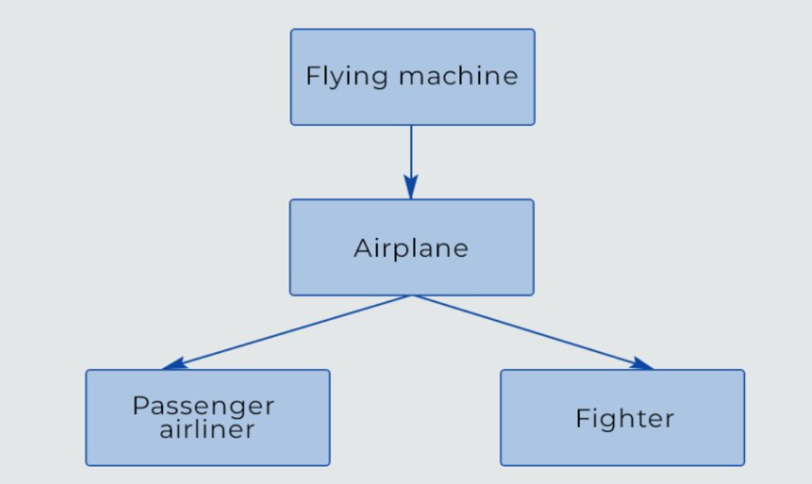
Failure to use inheritance
If a subclass uses only a small subset of the parent class's functions, then it smells of the wrong hierarchy. When this happens, usually the superfluous methods are simply not overridden or they throw exceptions. One class inheriting another implies that the child class uses nearly all of the parent class's functionality. Example of a correct hierarchy:
Notes:
Superfluous=extra

Slide 37
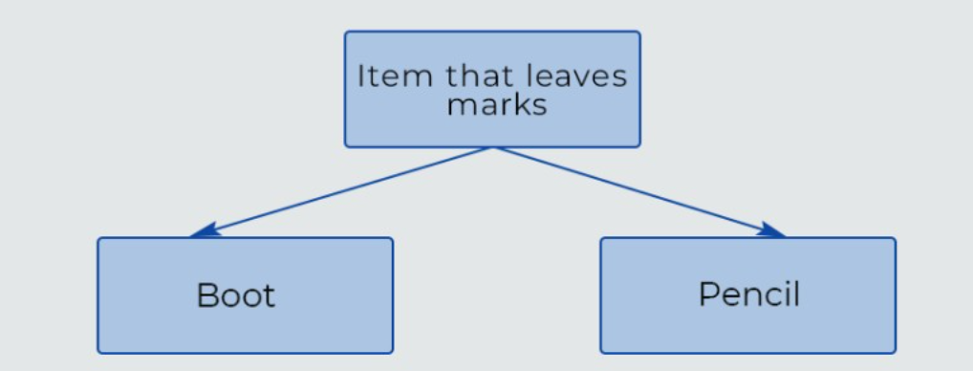
Example of an incorrect hierarchy:

Slide 38
Switch statement
What could be wrong with a switch statement? It is bad when it becomes very complex. A related problem is a large number of nested if statements
Alternative classes with different interfaces
Multiple classes do the same thing, but their methods have different names.
Temporary field
If a class has a temporary field that an object needs only occasionally when its value is set, and it is empty or, God forbid, null the rest of the time, then the code smells. This is a questionable design decision.
Smells that make modification difficult
These smells are more serious. Other smells mainly make it harder to understand code, but these prevent you from modifying it. When you try to introduce any new features, half of the developers quit, and half go crazy.

Slide 39
Uniformly distributed dependencies
Any modifications require you to look for all of a class's uses (dependencies) and make a lot of small changes. One change — edits in many classes.
Complex tree of modifications
This smell is the opposite of the previous one: changes affect a large number of methods in one class. As a rule, such code has cascading dependence: changing one method requires you to fix something in another, and then in the third and so on.
One class — many changes. "Garbage smells"
A rather unpleasant category of odors that causes headaches. Useless, unnecessary, old code. Fortunately, modern IDEs and linters have learned to warn of such odors.
A large number of comments in a method
A method has a lot of explanatory comments on almost every line. This is usually due to a complex algorithm, so it is better to split the code into several smaller methods and give them explanatory names.
Notes:
Cascading=flowing
A linter is a developer tool that analyzes source code for errors, vulnerabilities, and stylistic issues to improve code quality.

Slide 40
Duplicated code
Different classes or methods use the same blocks of code.
Lazy class
A class takes on very little functionality, though it was planned to be large.
Unused code
A class, method or variable is not used in the code and is dead weight.
Excessive connectivity
This category of odors is characterized by a large number of unjustified relationships in the code.
External methods
A method uses data from another object much more often than its own data.
Inappropriate intimacy
A class depends on the implementation details of another class.

Slide 41
Long class calls
One class calls another, which requests data from a third, which get data from a fourth, and so on. Such a long chain of calls means high dependence on the current class structure.
Task-dealer class
A class is needed only for sending a task to another class. Maybe it should be removed?
Refactoring techniques
Below we'll discuss basic refactoring techniques that can help eliminate the described code smells.

Slide 42
Basic refactoring techniques for the initial stage
Extract Methods and Functions
If there is a code fragment that can be grouped together, you should consider moving the code fragment into a new method or function. When there are more lines in a code snippet, it is harder to understand. Hence, we can create functions using the code that performs a particular task.

Slide 43
To understand this, consider the following code.
weight=int(input("Enter Weight in Kgs:"))
height=int(input("Enter height in cms:"))
heightInM=height/100
BMI=weight/heightInM**2
print("BMI is:",BMI)
The above code takes height and weight input from the user and prints BMI. Now, BMI can also have other applications in the program. So, it’s better to create a new function for calculating BMI. Also, having a separate function for each atomic task helps us reduce code duplication and isolates independent parts of code. To refactor the above code, we will use the following steps.

Slide 44
First, we will create new methods and name them in a way that makes their purpose clear.
Next, we will copy the existing codes to the relevant methods and delete the code snippets from their original place. After deletion, we will put a function call for each new method that we create at appropriate places.
If the variables inside a code fragment that we move to the new methods are declared inside the fragment and aren’t used anywhere else, we will leave them unchanged. These variables will become local variables for new methods.
If the variables are declared before the code in the new method, we will pass those variables as input to the new method.
If the variables are used after the code that we moved to the new method, we will return the variable value from the function.

Slide 45
Using the above steps, we can refactor the code given in the previous snippet as follows.
weight=int(input("Enter Weight in Kgs:"))
height=int(input("Enter height in cms:"))
def calculateBMI(weight,height):
heightInM=height/100
BMI=weight/heightInM**2
return BMI
def printBMI(BMI):
print("BMI is:",BMI)
BMI=calculateBMI(weight,height)
printBMI(BMI)
In the above code, we first split the code into three main components. The first code component takes inputs from the user. The second code component calculates BMI and the third code component prints the value.

Slide 46
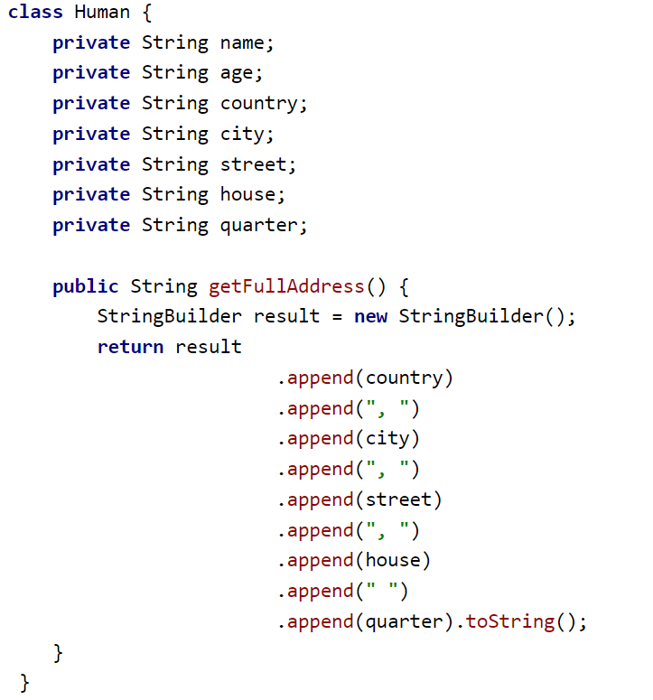
Extract a class
A class performs too many functions. Some of them must be moved to another class. For example, suppose we have a Human class that also stores a home address and has a method that returns the full address:

Slide 47
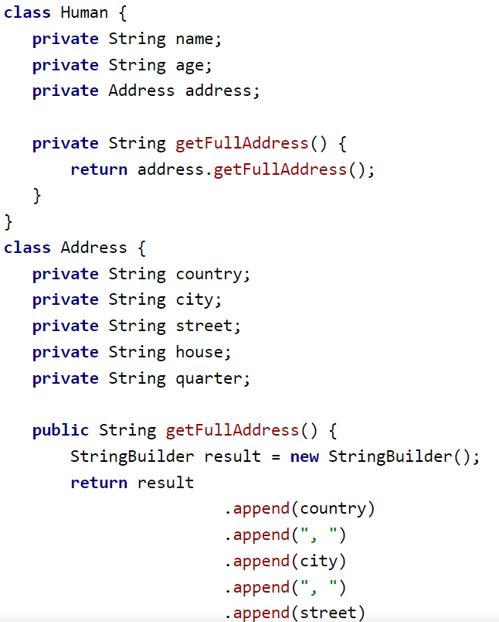
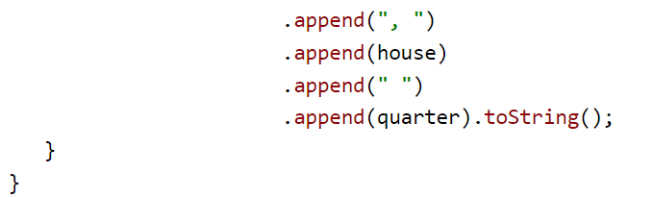
It's good practice to put the address information and associated method (data processing behavior) into a separate class:

Slide 48
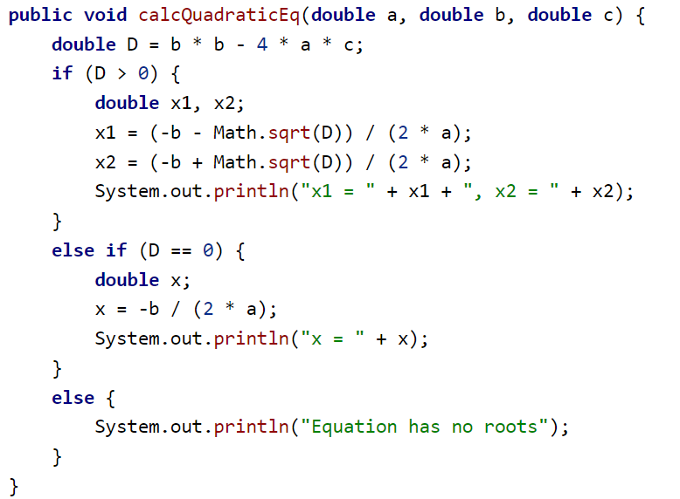
Extract a method
If a method has some functionality that can be isolated, you should place it in a separate method. For example, a method that calculates the roots of a quadratic equation:

Slide 49
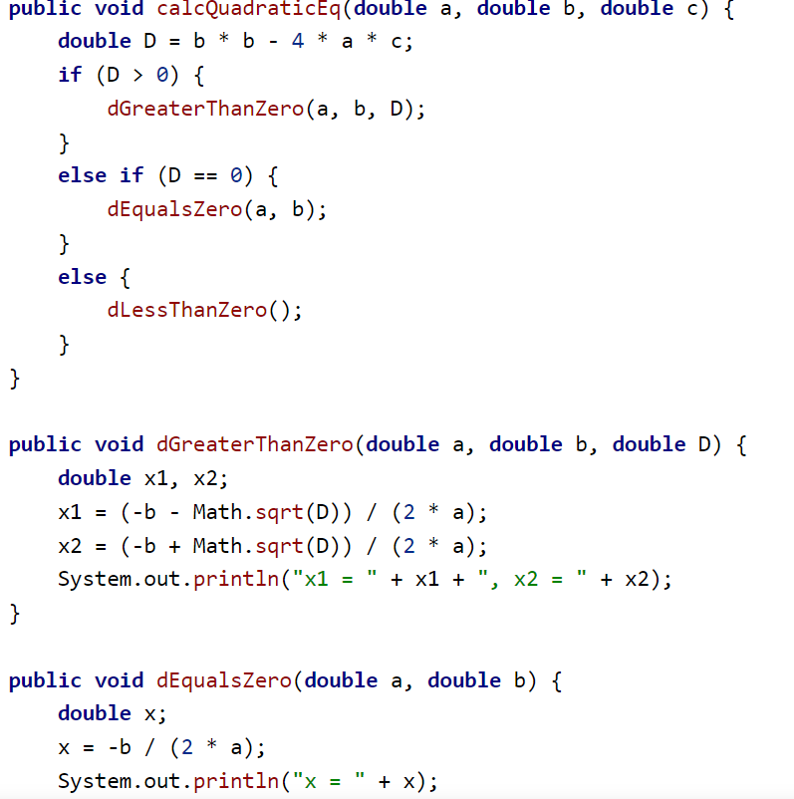
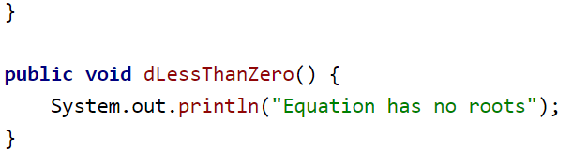
We calculate each of the three possible options in separate methods:
Each method's code has become much shorter and easier to understand.

Slide 50
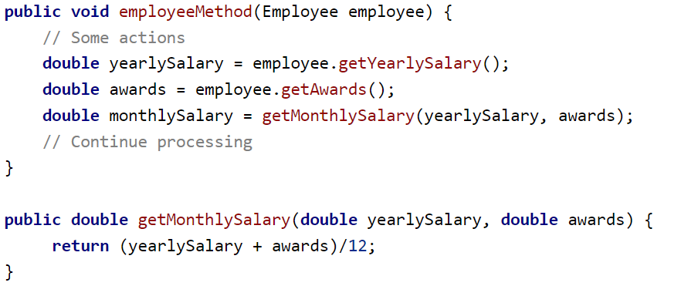
Passing an entire object
When a method is called with parameters, you may sometimes see code like this:

Slide 51
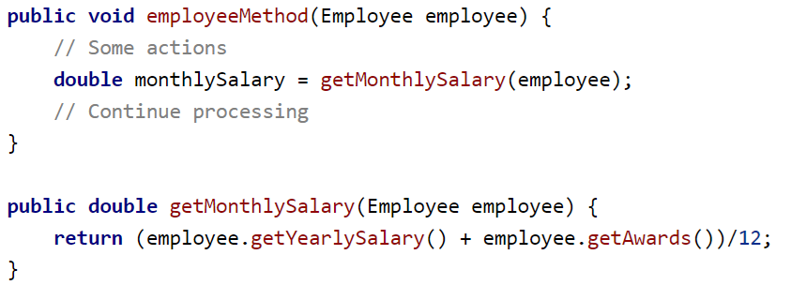
The employeeMethod has 2 whole lines devoted to receiving values and storing them in primitive variables. Sometimes such constructs can take up to 10 lines. It is much easier to pass the object itself and use it to extract the necessary data:

Slide 52
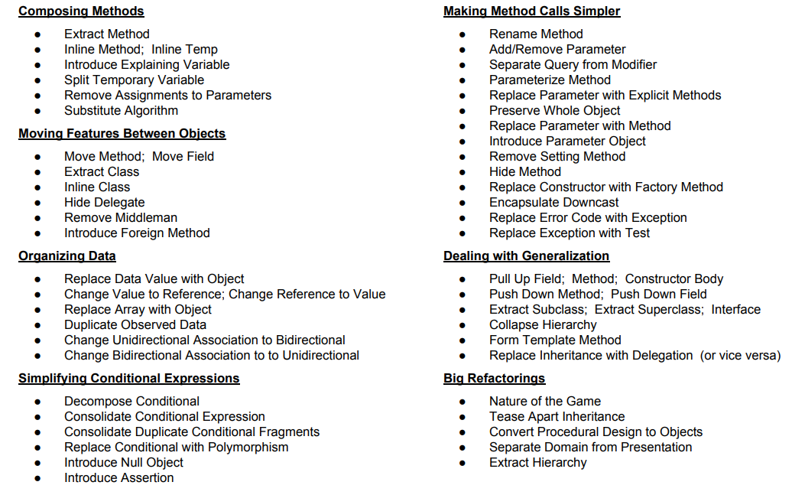
Code Refactoring Techniques

Slide 53
Refactorings - Composing Methods
If you have a complex code fragment that can exist independently, extract it into its own method- extract method

Slide 54
public class OrderProcessor {
// A simple method that merely wraps a calculation or constant
private double getDiscountAmount() {
// This is the entire body of the method
return 5.00;
}
public double calculateFinalPrice(double basePrice) {
double discount = getDiscountAmount(); // Calling the method
if (basePrice > 50.0) {
return basePrice - discount;
} else {
return basePrice;
}
}
}
Inline Method Refactoring
If you have a method that is extremely simple, inline it into locations where it is used.
1. Before: Over-factored Code
In this scenario, the getDiscountAmount method is so simple that its name doesn't really help clarify the intent, and its existence only adds a level of unnecessary indirection.

Slide 55
public class OrderProcessor {
// The method 'getDiscountAmount()' has been deleted.
public double calculateFinalPrice(double basePrice) {
// The simple method logic is now directly inlined
double discount = 5.00;
if (basePrice > 50.0) {
return basePrice - discount;
} else {
return basePrice;
}
}
}
2. After: Inlined Code
The call to getDiscountAmount() is replaced with its actual body (return 5.00;) , and the original method is removed.

Slide 56
public double calculateAdjustedPrice(double quantity, double itemPrice, double fixedDiscount) {
// tempValue is used to calculate the base price
double tempValue = quantity * itemPrice;
// tempValue is reassigned to apply a fixed discount
if (tempValue > 100) {
tempValue = tempValue - fixedDiscount;
}
// tempValue is reassigned again to apply a percentage discount
if (quantity > 10) {
tempValue = tempValue * 0.95; // 5% off
}
return tempValue;
}
If you assign values to a temporary variable more than once, split it into additional temporary variables.
1. Before: Reassigned Temporary Variable
In this example, the variable tempValue is used for three different purposes: it holds the base price, then the price after a fixed discount, and finally, the price after a percentage discount.
Problem: Reassigning the variable tempValue makes the code harder to debug. If a bug is found, you have to trace which calculation stage the variable currently holds.

Slide 57
2. After: Split Temporary Variables
The logic is refactored by creating a separate, well-named variable for each distinct calculation step.
public double calculateAdjustedPrice(double quantity, double itemPrice, double fixedDiscount) {
// 1. Calculate the initial base price
double basePrice = quantity * itemPrice;
// 2. Apply a fixed discount (using a new variable)
double priceAfterFixedDiscount = basePrice;
if (basePrice > 100) {
priceAfterFixedDiscount = basePrice - fixedDiscount;
}
// 3. Apply a percentage discount (using a new variable)
double finalPrice = priceAfterFixedDiscount;
if (quantity > 10) {
finalPrice = priceAfterFixedDiscount * 0.95; // 5% off
}
return finalPrice;
}

Slide 58
If assignments are made to parameter variables in a method, instead assign to a temporary variable.
Example:
Before: Assigning to a Parameter
In this example, the method calculates the total price after applying a sales tax. The input parameter price is directly modified and used to store the intermediate calculation, which is considered a bad practice.
public double calculateFinalPrice(double price, double taxRate) {
// 1. The 'price' parameter is directly reassigned.
price = price * (1.0 + taxRate);
// 2. 'price' is reassigned again to apply a service fee.
if (price < 10.0) {
price = price + 2.50; // Add service fee for small orders
}
// The original input value of 'price' is lost.
return price;
}
Problem: Modifying the price parameter is confusing because the name price initially suggests the original input, but it quickly changes to mean "price with tax" and then "final price." This makes it hard to see what the original value was and can lead to confusion if the language were "pass-by-reference" (though Java is "pass-by-value").

Slide 59
public double calculateFinalPrice(double price, double taxRate) {
// 1. Introduce a temporary variable to hold the result of the calculation.
double finalPrice = price * (1.0 + taxRate);
// 2. Modify the temporary variable, leaving the 'price' parameter intact.
if (finalPrice < 10.0) {
finalPrice = finalPrice + 2.50; // Add service fee for small orders
}
// The original input 'price' remains available but 'finalPrice' is returned.
return finalPrice;
}
After: Remove Assignments to Parameters
The refactored code introduces a new, well-named temporary variable (finalPrice) to hold the intermediate calculations, leaving the input parameter (price) untouched.

Slide 60
If an algorithm is hard to understand, swap it for a version that is clearer.
1. Before: Complex/Obscure Algorithm
Imagine you have a legacy method that needs to find a specific user ID in a list of mixed data types (a common pattern in older, less-typed codebases or scripts). It uses a very condensed, tricky approach that minimizes lines of code but sacrifices clarity.
import java.util.List;
public class DataProcessor {
// This method finds the first user ID (an Integer) in a mixed list
public Integer findFirstUserId(List<Object> mixedList) {
// Obscure: Using an early return inside a simple for loop with a type check.
// The condition 'if (item instanceof Integer)' is the key logic.
for (Object item : mixedList) {
if (item instanceof Integer) {
return (Integer) item;
}
}
return null;
}
}
Problem: While short, this method doesn't immediately tell the reader what it is looking for. The intent is hidden within the instanceof check and the immediate return.

Slide 61
import java.util.List;
import java.util.Optional;
import java.util.stream.Collectors;
public class DataProcessor {
// Substituted: Using a Stream pipeline for declarative clarity.
public Integer findFirstUserId(List<Object> mixedList) {
// Clearer: The steps are explicitly named: filter, map, findFirst.
Optional<Integer> result = mixedList.stream()
.filter(item -> item instanceof Integer) // Clearly filter for Integer types
.map(item -> (Integer) item) // Cast the filtered items to Integer
.findFirst(); // Stop and return the first one found
// Return the Integer or null if not found
return result.orElse(null);
}
}
2. After: Substituted (Clearer) Algorithm
We can replace the simple loop with a clearer, more modern approach using the Java Stream API, which explicitly names the actions being performed: filtering for Integar and finding the first match.

Slide 62
Refactorings - Moving Features Between Objects
If a method or field is used more by a calling class than the class it is placed in, move it.
This technique is formally known as Move Method or Move Field. The goal is to reduce coupling and improve cohesion by placing the functionality (method or field) closest to the data it operates on or the class that uses it most frequently.
Notes:
Delegates=agents/representatives

Slide 63
Move Method Example
// Class 1: Customer (The method is placed here)
public class Customer {
private String name;
// Method uses Order data, indicating it might belong elsewhere
public int calculateLoyaltyPoints(Order order) {
// This method heavily relies on order.getAmount()
double amount = order.getAmount();
// Complex logic based on order amount
if (amount > 100.0) {
return (int) (amount / 10.0);
} else {
return (int) (amount / 20.0);
}
}
// ... other Customer-specific methods (e.g., getName)
}
// Class 2: Order (The method uses its data)
public class Order {
private double amount;
public double getAmount() {
return amount;
}
// ... other Order-specific methods (e.g., getOrderDate)
}
1. Before: Poor Cohesion
Imagine a system with two classes: Customer and Order. The logic to calculate a customer's total loyalty points is currently placed in the Customer class, but the calculation heavily relies on the Order object's data (the order amount).
Problem: If the logic for calculating points changes based on the order's structure (e.g., its date, its items), you have to modify the Customer class, even though the logic is about the Order. This indicates low cohesion in Customer and high coupling between the classes.

Slide 64
2. After: Move Method
// Class 2: Order (The method is moved here)
public class Order {
private double amount;
public double getAmount() {
return amount;
}
// The logic is now correctly placed next to the data it operates on
public int calculateLoyaltyPoints() {
// Uses its own instance variable 'amount'
if (this.amount > 100.0) {
return (int) (this.amount / 10.0);
} else {
return (int) (this.amount / 20.0);
}
}
// ...
}
The method calculateLoyaltyPoints is moved to the Order class, as its primary input is the Order’s internal data (amount). The Customer class now simply calls the method on the Order object.
Step A: The Order Class (The New Home)
The method is moved here and no longer needs the Order object passed as an argument, as it now operates on its own instance data (this.amount).

Slide 65
// Class 1: Customer (The method is removed from here)
public class Customer {
private String name;
// The previous method is gone!
// An example of a method that now uses the new, better-placed method
public void awardPoints(Order order) {
int points = order.calculateLoyaltyPoints(); // Delegation
// ... logic to award points to the customer
}
// ...
}
Step B: The Customer Class (The Caller)
The old method is removed, and the calling code is updated to delegate the responsibility to the Order object.

Slide 66
If a class is doing more work than it should (or has low cohesion), extract a subset of related methods into a new class- Extract class (already discussed)
If a class is doing too little, combine it with another.
This technique is formally known as Inline Class. It is the opposite of Extract Class and is used when a class has become too weak, simple, or highly coupled to another class, where it no longer justifies its own existence. The goal is to reduce unnecessary complexity and remove an extra layer of indirection.

Slide 67
Inline Class Example
// Class 1: Address (The class doing too little)
public class Address {
private String street;
private String city;
private String postalCode;
// Only provides simple getters/setters, no complex behavior
public String getFullAddress() {
return street + ", " + city + " " + postalCode;
}
}
// Class 2: Employee (Highly dependent on the Address object)
public class Employee {
private String name;
private Address officeAddress; // Has a reference to the simple Address class
public Employee(String name, String street, String city, String postalCode) {
this.name = name;
this.officeAddress = new Address(street, city, postalCode);
}
// A method that merely delegates the address responsibility
public String getOfficeLocation() {
return officeAddress.getFullAddress();
}
}
1. Before: Too Little Responsibility Address details for an Employee were prematurely extracted into their own class.
Problem: The Address class is merely a simple container for a few fields and one trivial formatting method. It doesn't perform any complex validation, calculations, or unique domain logic. Its existence adds indirection without adding meaningful abstraction.

Slide 68
// Class 2: Employee (The fields are moved here)
public class Employee {
private String name;
// Fields from the old Address class are now directly in Employee
private String officeStreet;
private String officeCity;
private String officePostalCode;
public Employee(String name, String street, String city, String postalCode) {
this.name = name;
this.officeStreet = street; // Assign directly
this.officeCity = city;
this.officePostalCode = postalCode;
}
// The simple method logic is now directly in Employee
public String getOfficeLocation() {
return officeStreet + ", " + officeCity + " " + officePostalCode;
}
// ...
}
// The Address class is now deleted.
2. After: Inlined Class
The fields and the simple methods from the Address class are moved directly into the Employee class, and the separate Address class is deleted.
Step A: The Employee Class (The New Home)

Slide 69
If a class delegates too many calls to a middleman class, get rid of the middleman and call the client directly.
1. Before: Excessive Delegation
Imagine a system where an Employee class wants to access data about their insurance plan, which is managed by a Benefits class, which, in turn, holds the actual details in an InsurancePlan class. The Employee class acts as the "Middle Man."
// Class 1: The Client (Needs the Insurance Details)
public class Client {
public static void main(String[] args) {
Employee employee = new Employee("Alice");
// Client has to go through the middle man (Employee) to get to the data
// This is the "middle man" call: employee.getBenefits().getPlanDetails()...
String planType = employee.getBenefits().getInsurancePlan().getPlanType();
System.out.println("Alice's plan: " + planType);
}
}
// Class 2: Employee (The Middle Man)
public class Employee {
private Benefits benefits; // Holds the delegate object
public Employee(String name) {
// Assume benefits is initialized here
this.benefits = new Benefits();
}
// Exposes the delegate object's getter. This is the problem.
public Benefits getBenefits() {
return benefits;
}
}

Slide 70
// Class 3: Benefits (The Delegate)
public class Benefits {
private InsurancePlan insurancePlan;
public Benefits() {
this.insurancePlan = new InsurancePlan("Premium PPO");
}
// Exposes the delegate object's getter.
public InsurancePlan getInsurancePlan() {
return insurancePlan;
}
}
// Class 4: InsurancePlan (The Target)
public class InsurancePlan {
private String planType;
public InsurancePlan(String planType) {
this.planType = planType;
}
public String getPlanType() {
return planType;
}
}
Problem: To get the plan type, the client code must know the internal structure of Employee (that it has Benefits ) and the internal structure of Benefits (that it has an InsurancePlan). This creates a long, brittle delegation chain:
employee.getBenefits().getInsurancePlan().getPlanType()

Slide 71
2. After: Remove Middle Man
We refactor the code to remove the Middle Man (Employee) from the chain of calls by having the client (Client) call the ultimate target (InsurancePlan) directly, or by having the target (InsurancePlan) moved closer to the client. The most common solution is to provide a method that calls the target directly.
In this case, since Employee is the middle man, we make the client access the required object directly. However, if that is not possible, we put the target object's method on the middle man itself.
The solution below focuses on the simplest fix: making the Employee not expose the Benefits object.

Slide 72
Step A: Refactor Employee and Benefits (Eliminate Exposure)
We remove the exposed getter methods that reveal the object's structure (getBenefits() and getInsurancePlan() ).
Step B: Update the Client to Access the Target Directly (If possible)
Since the Client cannot simply guess the InsurancePlan object, we must update the Employee class to provide a direct access method to the target functionality.

Slide 73
// Class 3: Benefits (Updated to be more helpful)
public class Benefits {
private InsurancePlan insurancePlan;
// ... constructor ...
// The problematic public getter is REMOVED: // public InsurancePlan getInsurancePlan()
// NEW: Provides the required functionality directly
public String getInsurancePlanType() {
return this.insurancePlan.getPlanType();
}
}
// Class 1: The Client (Simplified Call)
public class Client {
public static void main(String[] args) {
Employee employee = new Employee("Alice");
// Client now calls the Employee directly for the specific information
String planType = employee.getInsurancePlanType();
System.out.println("Alice's plan: " + planType);
}
}
// Class 2: Employee (The Middle Man is gone)
public class Employee {
private Benefits benefits;
// ... constructor ...
// The problematic public getter is REMOVED: // public Benefits getBenefits()
// NEW: Employee delegates directly to the target functionality without returning the intermediate object.
public String getInsurancePlanType() {
// Employee takes the responsibility of calling the delegate's methods internally
return this.benefits.getInsurancePlanType();
}
}

Slide 74
If an imported class needs an additional method, but you can’t modify it directly, create a method in the client class with the imported object as a parameter.
This technique is formally known as Introduce Foreign Method. It's used when you are dealing with a class from a third-party library or a framework that you cannot change (a "foreign class"), but you need to add specific, client-side functionality to it.

Slide 75
Introduce Foreign Method Example
// Foreign Class (We cannot modify this source file!)
public class Rectangle {
private double width;
private double height;
public Rectangle(double width, double height) {
this.width = width;
this.height = height;
}
public double getWidth() { return width; }
public double getHeight() { return height; }
}
// Client Class (The code we are writing)
public class GeometryCalculator {
// ... other methods ...
}
1. The Scenario: A Foreign Class
Imagine you are using a third-party geometry library that provides a simple Rectangle class. You need a method to calculate the area of the smallest circle that can contain the rectangle (the circumcircle area), but you cannot modify the library's source code.

Slide 76
2. After: Introduce Foreign Method
You implement the required functionality as a new, static method within your own GeometryCalculator class (the client), accepting the foreign Rectangle object as an argument.
// 2. The radius (r) is half the diagonal
double radius = diagonal / 2.0;
// 3. Area = pi * r^2
return Math.PI * pow(radius, 2);
}
// Example usage:
public static void main(String[] args) {
Rectangle window = new Rectangle(4.0, 3.0);
// Calling the foreign method with the foreign object as a parameter
double area = calculateCircumcircleArea(window);
System.out.println("Circumcircle Area: " + area); // Output: ~19.63
}
}
import static java.lang.Math.pow;
import static java.lang.Math.sqrt;
// Client Class with the Foreign Method
public class GeometryCalculator {
// This is the Foreign Method!
public static double calculateCircumcircleArea(Rectangle rect) {
// 1. Calculate the diagonal (d) of the rectangle (which is the circle's diameter)
// d = sqrt(w^2 + h^2)
double diagonal = sqrt(pow(rect.getWidth(), 2) + pow(rect.getHeight(), 2));

Slide 77
Refactorings - Conditional Expressions & Data
If your conditional statements are too complex, extract methods from the if, then, and else conditions.
Extract Conditional Logic Example
The goal is to replace complex logic with a method call that has a clear, descriptive name. This makes the conditional structure read like a human-language sentence.
Notes:
Consolidate=combine

Slide 78
public class ShippingManager {
// Constants for criteria
private static final double MIN_ORDER_AMOUNT = 50.0;
private static final int MIN_LOYALTY_LEVEL = 3;
public boolean checkFreeShippingEligibility(double orderTotal, int loyaltyLevel, boolean isFirstOrder, int zone) {
// Complex condition and internal logic crammed together
if ((orderTotal >= MIN_ORDER_AMOUNT && loyaltyLevel >= MIN_LOYALTY_LEVEL) ||
(isFirstOrder && orderTotal > 20.0 && (zone == 1 || zone == 2)))
{
// Complex logic in the 'then' block
System.out.println("Processing with free shipping...");
return true;
} else {
System.out.println("Standard shipping rules apply.");
return false;
}
}
}
1. Before: Complex Conditional Logic
Imagine a method that determines if an online order is eligible for free shipping. The criteria are complex and the logic is embedded directly in the if statement and then block.
Problem: The if condition is nearly unreadable
(a Conditional Logic code smell), and the then
and else blocks contain logic that obscures the
intent of the main method.

Slide 79
public class ShippingManager {
// Constants for criteria (remain the same)
private static final double MIN_ORDER_AMOUNT = 50.0;
private static final int MIN_LOYALTY_LEVEL = 3;
public boolean checkFreeShippingEligibility(double orderTotal, int loyaltyLevel, boolean isFirstOrder, int zone) {
// The main method now reads like an outline of the logic:
if (isEligibleForFreeShipping(orderTotal, loyaltyLevel, isFirstOrder, zone)) {
handleFreeShippingConfirmation();
return true;
} else {
handleStandardShippingConfirmation();
return false;
}
}
2. After: Extracted Conditional Logic
We extract the complex boolean expression into a method, and the logic within the blocks into separate methods.

Slide 80
// Extracted Method 1: The 'if' condition (The boolean expression)
private boolean isEligibleForFreeShipping(double total, int level, boolean first, int zone) {
// Condition 1: High value + loyalty
boolean highValueAndLoyalty = (total >= MIN_ORDER_AMOUNT && level >= MIN_LOYALTY_LEVEL);
// Condition 2: First order in local zones
boolean firstOrderLocal = (first && total > 20.0 && (zone == 1 || zone == 2));
return highValueAndLoyalty || firstOrderLocal;
}
// Extracted Method 2: The 'then' block
private void handleFreeShippingConfirmation() {
System.out.println("Processing with free shipping...");
// Additional complex logic would go here
}
// Extracted Method 3: The 'else' block
private void handleStandardShippingConfirmation() {
System.out.println("Standard shipping rules apply.");
// Additional complex logic would go here
}
}

Slide 81
If you have a sequence of conditional tests with the same result or repeated conditions in each branch, consolidate them into fewer conditional statements.
This technique is formally known as Consolidate Conditional Expression (or Consolidate Duplicate Conditional Fragments). The goal is to combine multiple, redundant checks into a single, cohesive conditional statement, often using logical operators (&&, ||).

Slide 82
Consolidate Conditional Expression Example
public class EmployeeBonus {
private static final int BONUS_RATE = 1000;
public int getSpecialBonus(boolean isHighPerformer, boolean hasPerfectAttendance, boolean isTenured) {
// Duplicated result (returning 1000) in multiple branches
if (isHighPerformer) {
return BONUS_RATE;
}
if (hasPerfectAttendance) {
return BONUS_RATE;
}
if (isTenured) {
return BONUS_RATE;
}
// The default case
return 0;
}
}
1. Before: Duplicated Condition/Result
Imagine a method that checks if an employee is eligible for a special bonus. The logic checks for three different conditions, and if any one of them is met, the same result (a bonus rate of $1000) is returned.
Problem: The code is repetitive, and if the BONUS_RATE
ogic were more complex, you would have to maintain it
in three different places. The intent is obscured by the
sequential if checks.

Slide 83
2. After: Consolidate Conditional Expression
We combine the separate checks into a single if statement using the logical OR operator (||) and move the duplicated result logic into the consolidated then block.
public class EmployeeBonus {
private static final int BONUS_RATE = 1000;
public int getSpecialBonus(boolean isHighPerformer, boolean hasPerfectAttendance, boolean isTenured) {
// Consolidated the three separate checks into one condition
if (isHighPerformer || hasPerfectAttendance || isTenured) {
// The result is now in only one place
return BONUS_RATE;
}
// The default case
return 0;
}
}

Slide 84
If you have an attribute that needs additional data or operations, turn it into a new type of data object.
If certain array values have special meaning, use a class to store items instead.

Slide 85
Refactorings - Simplifying Method Calls and Generalization
If a method both returns a value and changes the state of a passed object, split into two methods and separate the query from the modifier. (This principle tells us to separate code responsible for getting data from code that changes something inside an object.)
If several methods do similar things - differentiated by value - create one method that takes the value as a parameter.
If two classes have the same attribute/method/constructor body, pull it up into the parent. If an item is only used by some subclasses, push it into the children.
If a class has features only used situationally, extract subclasses for those situations.

Slide 86
Data refactoring
Some refactorings may also occur because of changes to the data structure supporting the code. Such changes often take place due to a deeper understanding of the data model, as well as additions and subtractions to the collected data.
Refactoring takes place in both the data and data model as well. While code refactoring can happen without data model refactoring, code is nearly always affected by changes to the underlying data model. Data refactoring becomes the source of refactors for the model, storage system and code. Each piece needs careful planning and thorough understanding, which adds considerable project resources.

Slide 87
Looking at the data refactoring component of a project, there are several tasks that accompany it, including:
Making changes to the data model to fit the new case, feature, etc.
Aligning the data model with the storage technology’s format, such as relational, graph or other. Each type of data storage format comes with its own set of rules, so we often end up making further changes to the data to accommodate the required structure.
This “translation” step between data model and data storage steps is what can be cumbersome, especially when it’s accompanied by change approvals from project managers for properly aligning data structures between the real-world configuration of data and the structured format of the database. Graph databases can shorten or cut the translation phase because they more naturally model data as it exists in the real world.

Slide 88

Data Refactoring for Databases
The example data set is in Tables 1 and 2 below. Shop locations include data about the location type, size, address details, phone number and assigned manager. The staff table contains names, positions, start date and assigned shop location for each associate.
Table 1: The shop location table

Slide 89
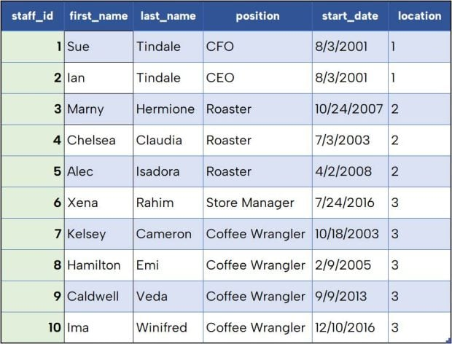
Table 2: The staff table

Slide 90
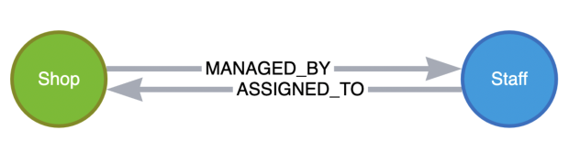
A graph representation of this data could look something like Figure 1 below.
Figure 1: Graph representation of shop locations and staff
In this graph model, we have two main entities (nodes): Shop and Staff. The relationships between these nodes tell us how they are connected. Either a staff member is assigned to work at a location or a shop is managed by a particular staff member.
Next, let’s look at how a few specific refactorings would affect each of these models.

Slide 91
Refactoring 1: Adding a New Column
Storing additional information is a common change among database projects. In our coffee shop case, we might want to also track the open date for a shop location (how long a location has been in operation). For a relational format, the change process would involve adding a new column to the table. This likely also entails:
Explaining the change to stakeholders.
Writing and executing a data definition language (DDL) statement to alter the table structure, or dropping the entire table and rebuilding it with the new column in the DDL.
Adding the new data to the population set.
Finally, importing the actual data to the table.

Slide 92

Between certain of these tasks, additional change approval steps may be required. This change does not affect the staff table, so no changes would be required there. The result of this refactoring would look like Table 3.
Table 3: Refactor No. 1 for shop location table

Slide 93
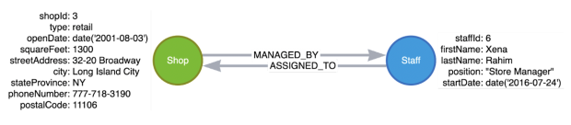
Meanwhile, for a graph format, we would need to add a new property to the Shop node. Similar to our relational process above, we would need to explain the change to stakeholders and get any necessary change approvals. However, dropping the data structure, making the addition and setting the new data structure are all eliminated with graph methodology because there is no strict DDL. With graph, the structure is not forced on the data. Rather, the data itself determines the structure and can be adapted when the information represented by the data shifts, as depicted in Figure 2.
Figure 2: Refactor No. 1 for graph

Slide 94
Refactoring 2: Adding a New Table and Relationship
Next, suppose we have issues with staffing coverage at our locations. We want to retain employee addresses to help us determine who might be able to cover a shift at another location.
While we could store employee addresses directly in the Staff table, addresses are more likely to change than other data, and we might want to keep staff’s personal details separate from their business information. We can create a separate table to store addresses, which means creating a foreign key relationship between the staff row and related address with a new column, as well as statements for the new table structure and data insert.

Slide 95
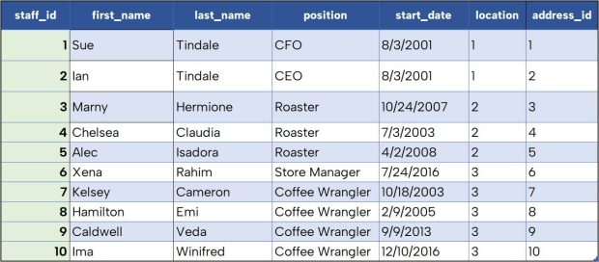
Table 4: Adding foreign key column address_id to Staff table

Slide 96
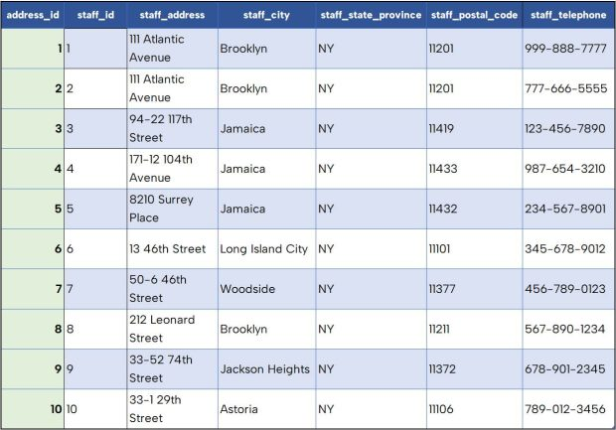
Table 5: New staff_address table

Slide 97

For graph, we would need to add the data for a new StaffAddress node and relationship to Staff nodes, as shown in Figure 3. Existing data would not be affected, so we would not need to alter Staff entities in the database.
Figure 3. Refactor No. 2 for graph

Slide 98
Refactoring 3: Adding Data to Existing Tables
For our third and final refactoring, business is booming, and we might want to add newly hired staff members to a new shop location.
With the relational structure, creating a new staff member in the table means adding a shop location assignment to make the row complete. We would likely need some sort of dependency rule (constraint) that ensures we could not insert a value in the Staff table’s location column if it does not exist in the Shop_Location table. If we want to add the new staff member’s address to the Staff_Address table, we’d need to set up the same guardrails in that table, as well. This means any new staff member assigned to a new location requires us to first create the location, and then the staff member, then their address. Doing these steps in the wrong order would result in errors.

Slide 99
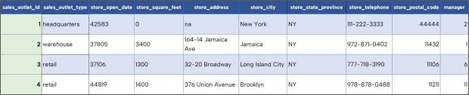
Table 6: Shop_Location table with new row

Slide 100
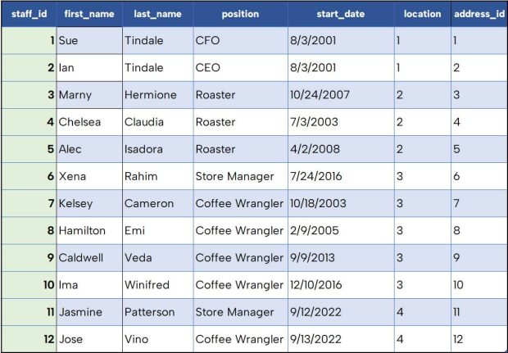
Table 7: Staff table with 2 new staff

Slide 101
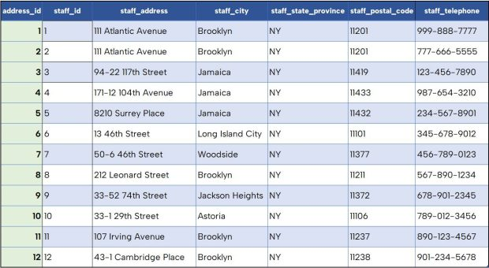
Table 8: Staff_Address table with 2 new addresses

Slide 102

For our graph version in Figure 4, we simply need to add the new data. Structure remains the same, and existing data is not affected.
Figure 4. Refactor No. 3 for graph

Slide 103
Refactoring data structures
Data structures are the building blocks of any software program, as they define how data is stored and manipulated in memory. Data structures can be simple, such as arrays, lists, stacks, or queues, or complex, such as trees, graphs, hash tables, or heaps. Data structures have different properties and operations, such as size, capacity, access time, insertion, deletion, sorting, searching, or traversal. Choosing the right data structure for your problem and data set is crucial for the efficiency and quality of your code.

Slide 104
Why refactor data structures?
Refactoring data structures can help you in many ways, such as simplifying your code and making it easier to read, reducing duplication and redundancy of data and code, optimizing memory and CPU resources, enhancing modularity and reusability, adapting to changing requirements and new features, improving testability and reliability, and avoiding potential errors caused by data inconsistency or corruption.

Slide 105
How to refactor data structures?
Refactoring data structures is not a one-size-fits-all process, but rather a context-dependent and iterative one.
To begin, you must analyze your code and identify the data structures that need refactoring.
The common steps and methods for refactoring data structures include reviewing your code and data flow to determine the purpose and scope of each data structure, evaluating performance and suitability to identify any issues or bottlenecks, choosing a new or alternative data structure that better fits your needs and goals, implementing the new structure in your code and updating any references or dependencies, testing your code to verify that functionality and behavior remain unchanged after refactoring, and repeating the process until you are satisfied with the results.

Slide 106
What are some examples of refactoring data structures?
When refactoring data structures, the type, complexity, and context of your code should be taken into consideration.
For instance, if you need to add or remove elements frequently, you might replace an array with a list. Alternatively, if you need to access elements by a key or a value, you might replace a list with a hash table.
Moreover, if you need to represent complex relationships between data nodes or perform advanced algorithms or traversals, you could replace a tree with a graph.
Finally, if you want to leverage existing functionality and performance of the library or avoid reinventing the wheel, you could replace a custom data structure with a standard library one.
Notes:
The List Data Structure is a unique set of ordered elements where the same value can occur multiple times and its characteristics include flexibility that allows individual access and edits of elements based on the position or index.
The Hash table data structure stores elements in key-value pairs where. Key- unique integer that is used for indexing the values; Value - data that are stored…..

Slide 107
What are the benefits and challenges of refactoring data structures?
Refactoring data structures can bring many benefits to your software engineering skills and code quality, such as improving your problem-solving and analytical skills, design and coding skills, performance and scalability skills, as well as testing and debugging skills.
However, refactoring data structures can also pose some challenges, such as introducing new errors or bugs, breaking existing functionality or behavior, increasing complexity or the learning curve, or taking too much time or effort.
Therefore, you need to be careful and systematic when refactoring data structures, and use the appropriate tools and techniques to facilitate and automate the process.

